Slide 1
DTP
Dynamic trunking protocol (DTP)

Slide 2
3.2.3 Trunking Modes
DTP (Dynamic Trunking Protocol)
Cisco proprietary protocol.
Auto negotiate weather the port is access or trunk.
The switch port will send a DTP message:
  if there is a reply then this port is connected to a Cisco switch →trunk port
  If there is no reply then this port is connected to a pc or non-Cisco switch →access port
If the port is connected to non-Cisco device (router or switch) ,you must configure it manually to be trunk.

Slide 3
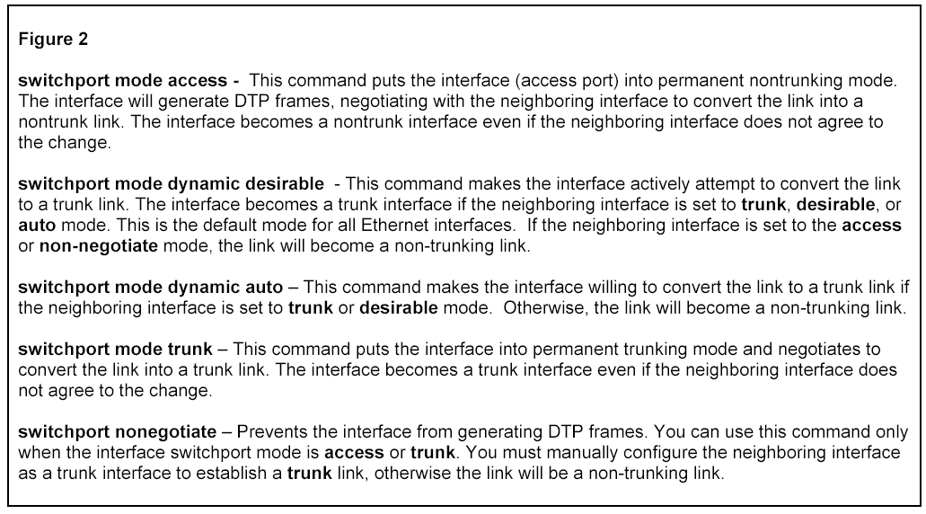

Slide 4
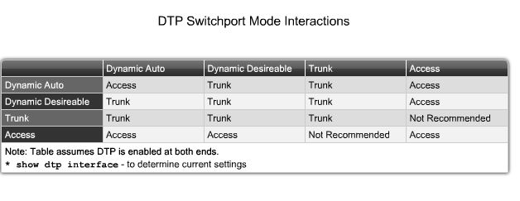
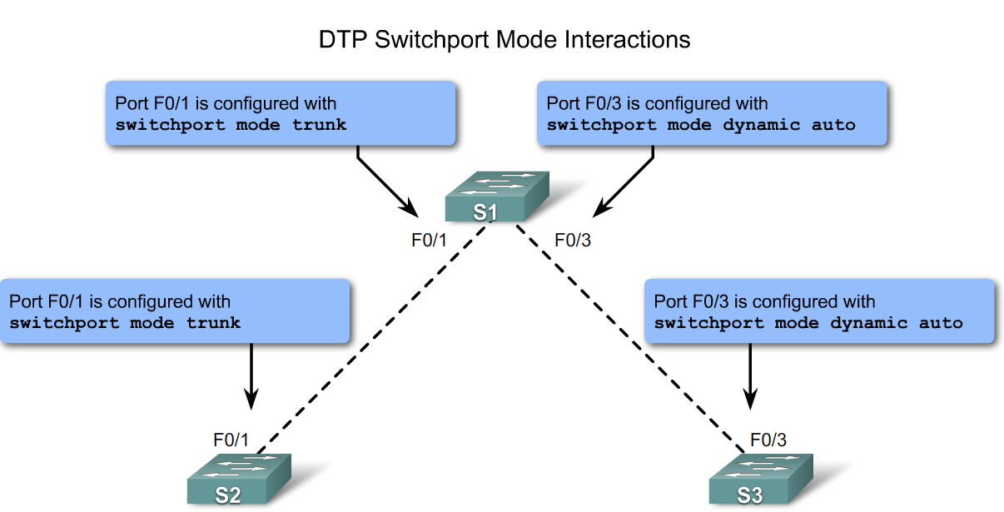
Notes:
Graphic 3.2.3.1

